Slide 1

Client/ Stakeholder Relations
Effective client and stakeholder relations are crucial for success. This section explores communication strategies, gathering feedback, managing expectations, and more.

Slide 2
Communication with Clients and Stakeholders
1
Clear and Consistent Messages
2
Active Listening
Establish open lines of communication to align expectations and keep all parties informed.
Listen attentively to understand client/stakeholder needs, concerns, and suggestions.
3
Adaptability
4
Timely Responses
Effective communication requires tailoring your approach to different individuals and cultures.
Respond promptly to clients/stakeholders, demonstrating respect for their time and concerns.

Slide 3
Client Feedback and Satisfaction
Feedback Loops
Surveys and Assessments
Active Engagement
Establish mechanisms for gathering feedback at various stages of the client/stakeholder engagement.
Engage in active dialogue to better understand and address client/stakeholder concerns.
Use surveys and assessments to collect quantitative and qualitative data on client satisfaction.

Slide 4
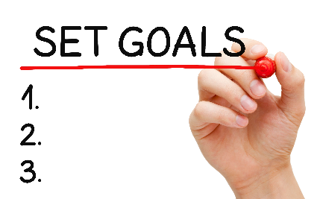

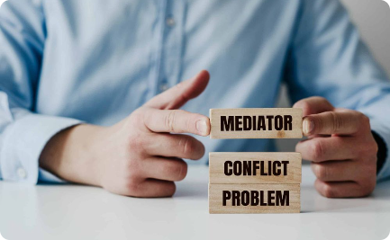
Managing Expectations
Setting Realistic Goals
Providing Transparency
Conflict Resolution
Align goals and milestones with clients/stakeholders to ensure mutual understanding and success.
Transparently communicate project progress, challenges, and changes to maintain trust.
Proactively address conflicts with professionalism, empathy, and genuine effort to find resolutions.

Slide 5

Building Trust and Maintaining Strong Relationships
1
Consistent Delivery
2
Personalized Approach
Consistently deliver on promises to build trust and credibility with clients/stakeholders.
Understand the unique needs and preferences of each client/stakeholder to foster strong relationships.
3
Reliability
Be reliable in meeting deadlines, fulfilling commitments, and communicating consistently.

Slide 6

Best Practices for Effective Communication
1
Written Communication
Master the art of clear and concise written communication to convey messages effectively.
Verbal Communication
2
Develop strong verbal communication skills to engage in meaningful and productive discussions.
3
Active Body Language
Use positive body language to enhance your communication, conveying openness and attentiveness.

Slide 7

The Importance of Regular Communication
Trust and Collaboration
Addressing Concerns
Regular communication builds trust and fosters collaboration with clients/stakeholders.
Addressing concerns promptly prevents potential issues from escalating into major problems.
Opportunity for Feedback
Regular check-ins provide an opportunity for clients/stakeholders to provide feedback for improvement.

